Slide 1
Silicon Hills vs. Tech Champions
Neighborhood Venue Analysis among Austin, Seattle, and San Francisco

Slide 2
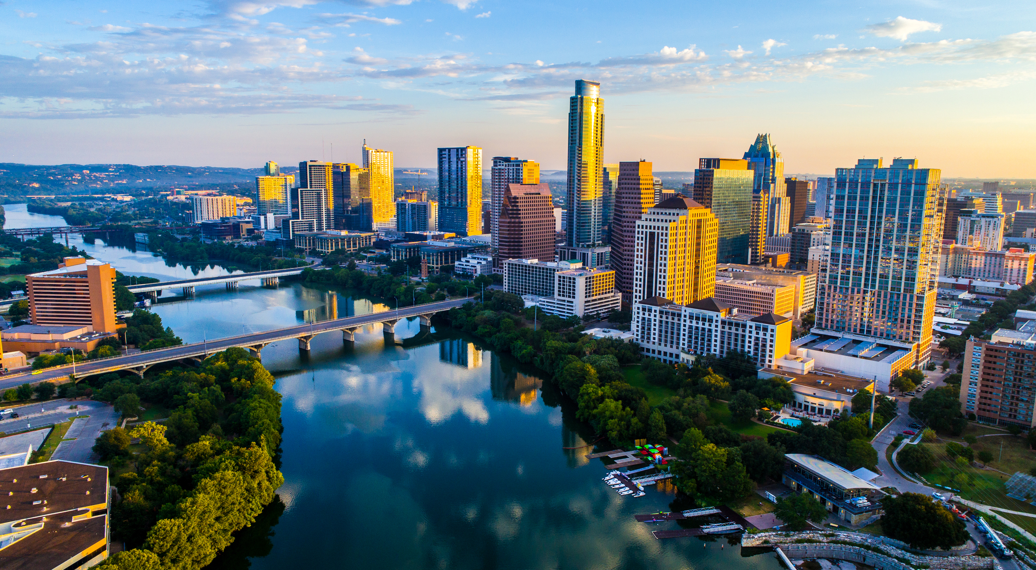
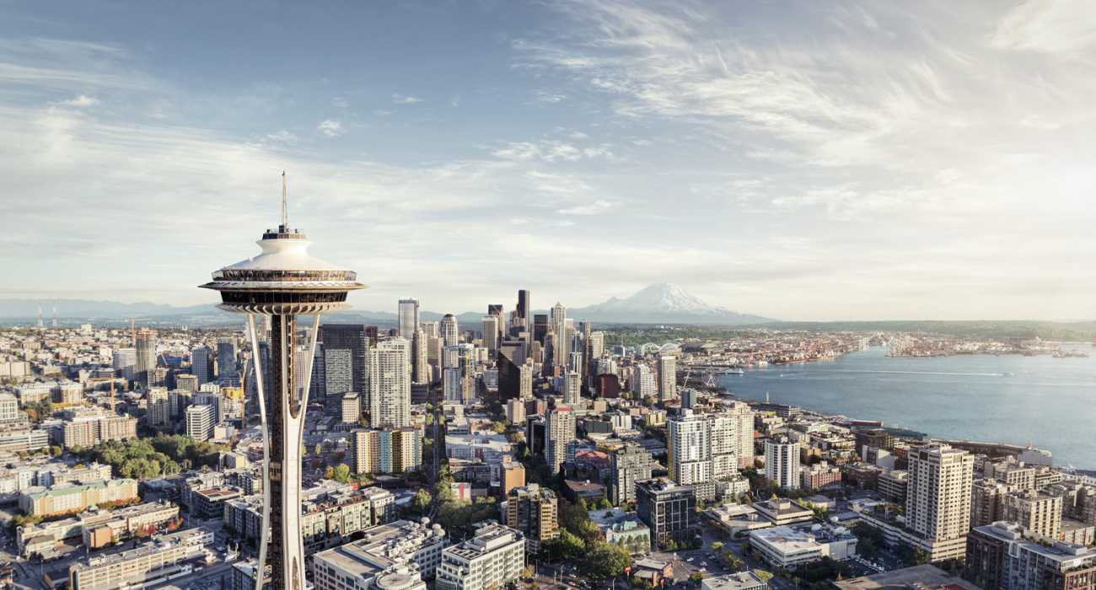
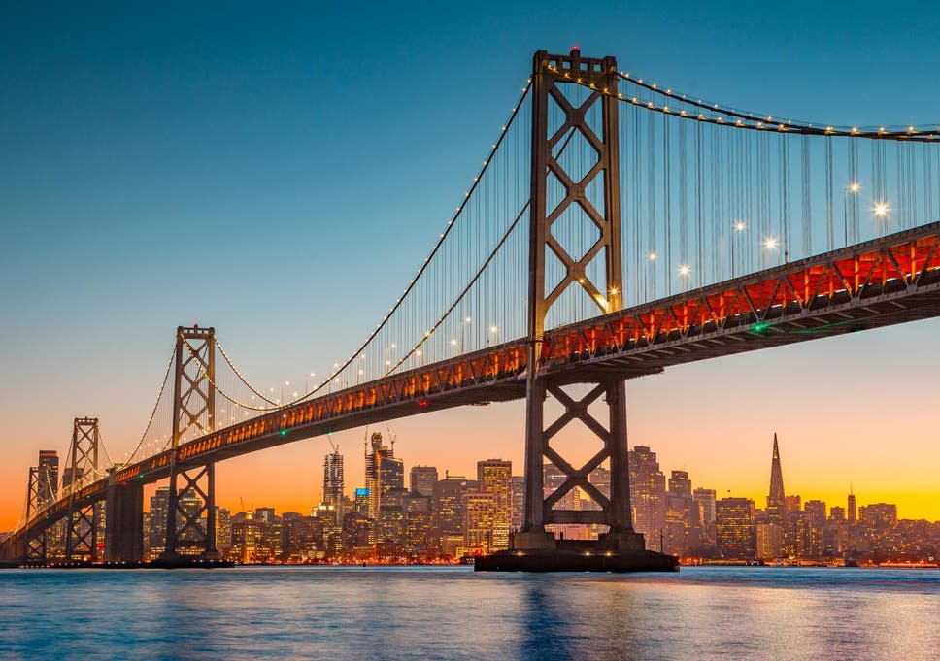
Austin is growing fast and the Area is nicknamed Silica Hills
What are the difference with respect to neighborhoods venues between Austin and tech champions like Seattle and San Francisco?
How can Austin improve its neighborhood venues to match Seattle and San Francisco?

Slide 3

Data Source and Treatment
Zip code as surrogate of neighborhoods
Zip code and latitude, longitude downloaded from:
https://public.opendatasoft.com/explore/dataset/us-zip-code-latitude-and-longitude/export/
Venue data from Foursquare API
Zip code is clustered using kmeans with respect to most common venues from Foursquare

Slide 4
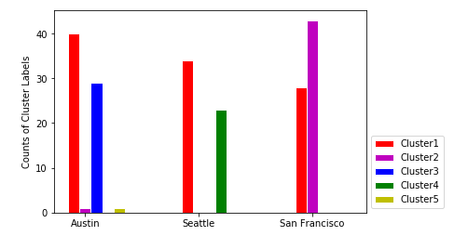
Zip Code Clustering reSults
Cluster 1 is important in all three cities
Only Austin has Cluster 3
Only Seattle has Cluster 4
Only San Francisco has significant Cluster 2

Slide 5
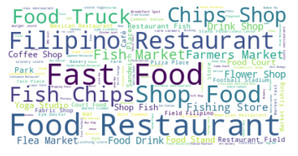
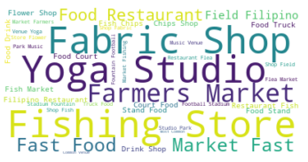
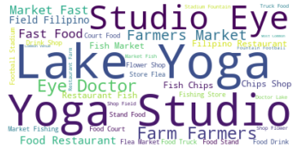
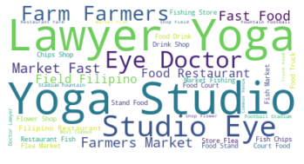
Composition of Each Cluster
Cluster 1: Austin, Seattle, San Francisco
Cluster 2: San Francisco
Cluster 3: Austin
Cluster 4: Seattle

Slide 6
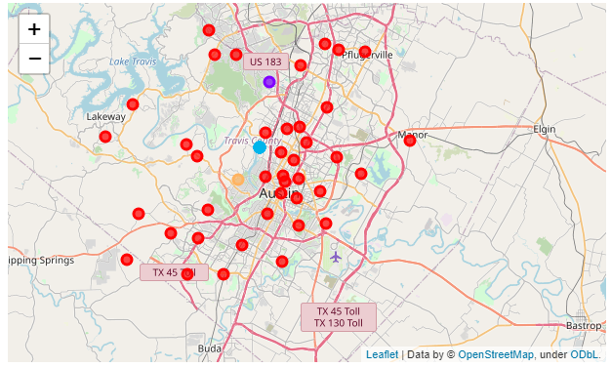
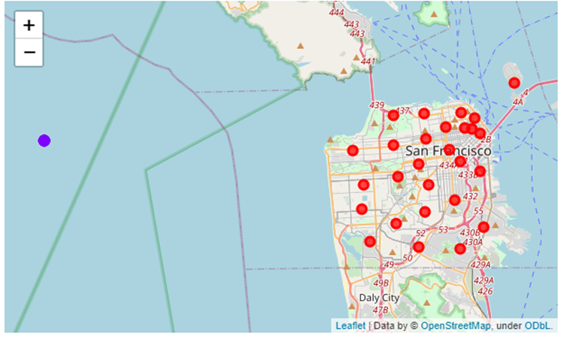
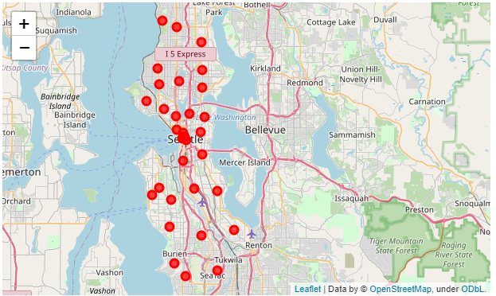
Cluster1 is evenly distributed, all other clusters are sporadic
Austin
San Francisco
Seattle

Slide 7
Conclusions
kmeans and word cloud are power tool to cluster and visualize venue composition of each zip code.
Austin is more similar to Seattle than to San Francisco.
All three cities have many zip codes whose primary venues are restaurants.
San Francisco stands out in term of farmers market and fabric shops probably thanks to its more liberal living culture.
Austin can improve its attraction to tech companies by develop more farmers market like San Francisco and develop more lawyer office like Seattle.

